Slide 1


Scaling Social Buzz: Big Data & IPO Strategy

Slide 2


Today's agenda
Project recap
Problem
The Analytics team
Process
Insights
Summary

Slide 3

Audit of Big Data Practices
Recommendations for a Successful IPO
Analysis of Content Categories: Top 5 Categories
Project Recap

Slide 4

Problem
How can Social Buzz manage its massive data effectively and identify the top 5 performing content categories to improve user engagement and support their IPO goals?

Slide 5



Marcus Rompton (Senior Principle)
The Analytics team
Andrew Fleming (Chief Technical Architect)
Marina Lozanskaya (Data Analyst)

Slide 6
Process
1
Data Collection
2
Data Cleaning
3
Data Modelling
4
Data Analysis
5
Uncover Insights

Slide 7
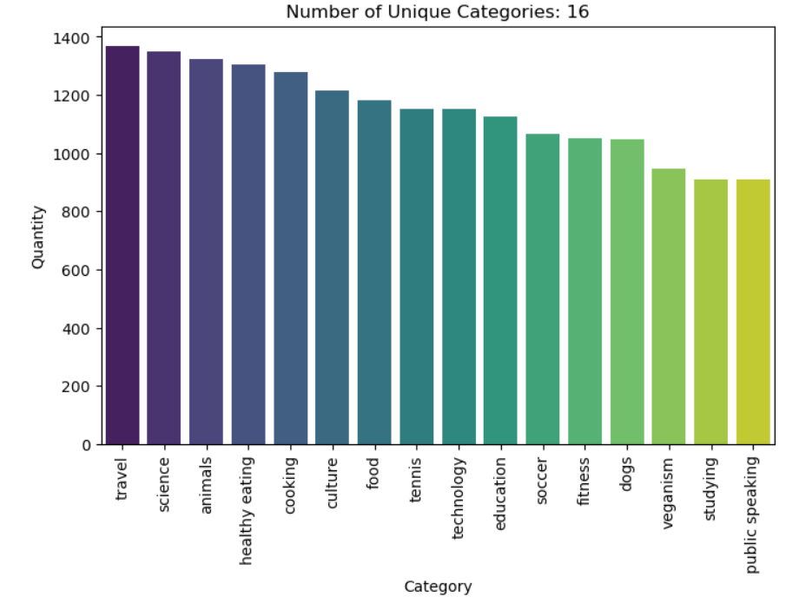

Insights
How many unique categories are there?

Slide 8
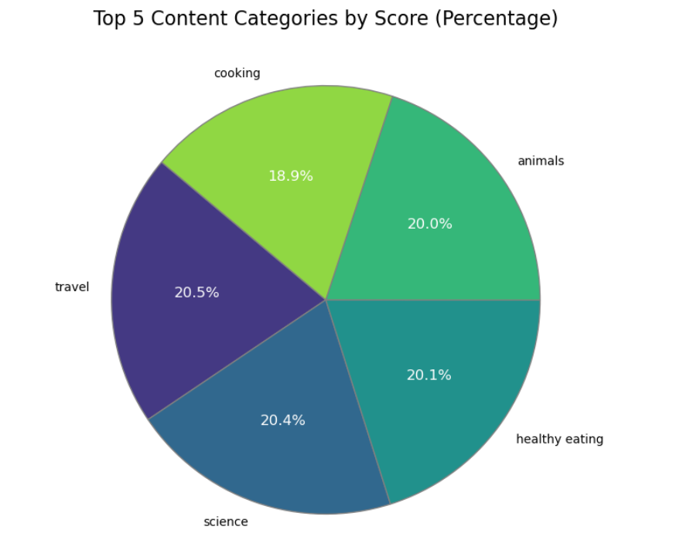
How many reactions are there to the most popular category?

Slide 9
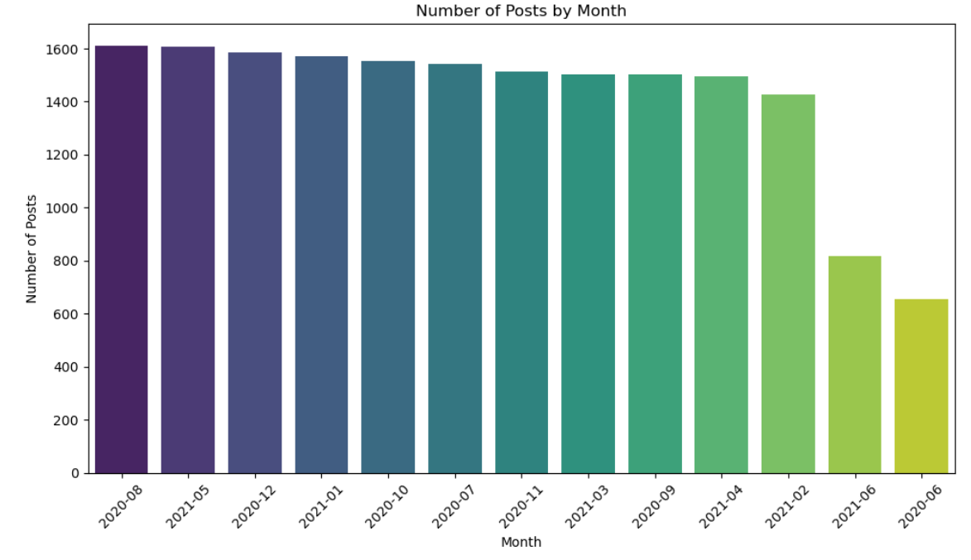
What was the month with the most posts?

Slide 10

Content Strategy:
Focus on top categories (Travel, Science, Animals, Healthy Eating….).
Align content with peak periods (e.g., August).
Personalize content for user interests.
Data Practices:
Upgrade data management tools.
Use advanced analytics for trend insights.
Conduct regular data audits.
IPO Support:
Highlight engagement metrics.
Scale infrastructure for data demands.
Develop a strategy using content and data insights.
Summary

Slide 11
Thank you!
ANY QUESTIONS?

